Slide 1
SERVER-SIDE WEB DEVELOPMENT
An Introduction to ASP.NET Projects / MVC Designs

Slide 2
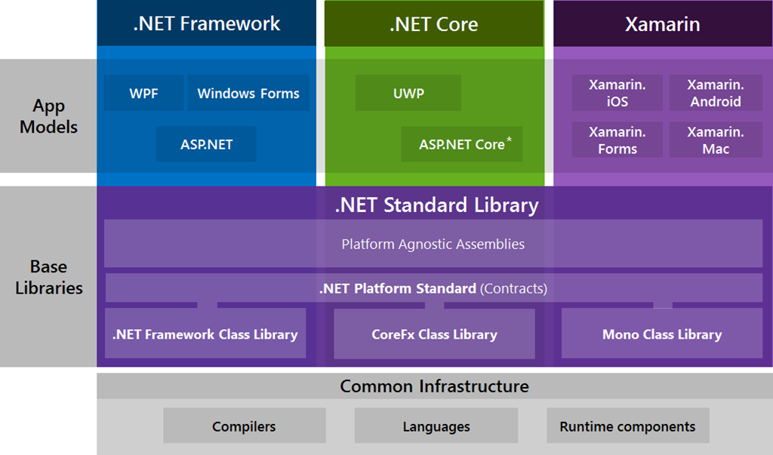
An Overview of Developing in .NET

Slide 3
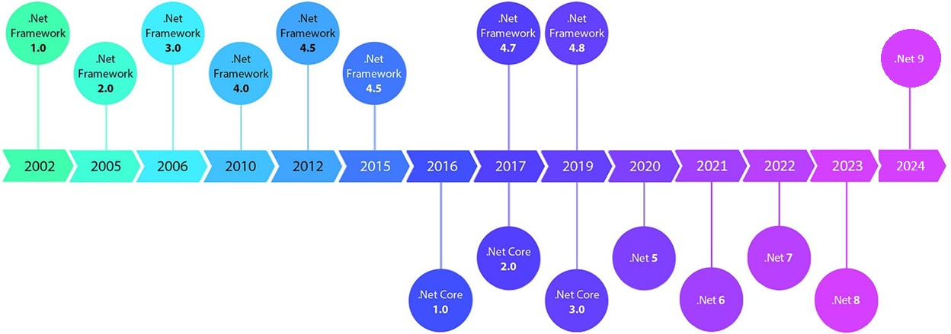
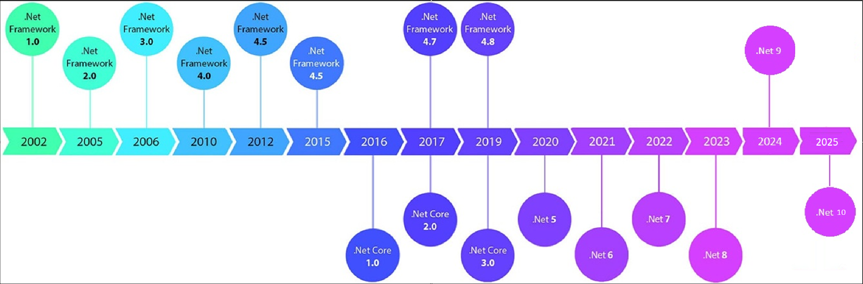
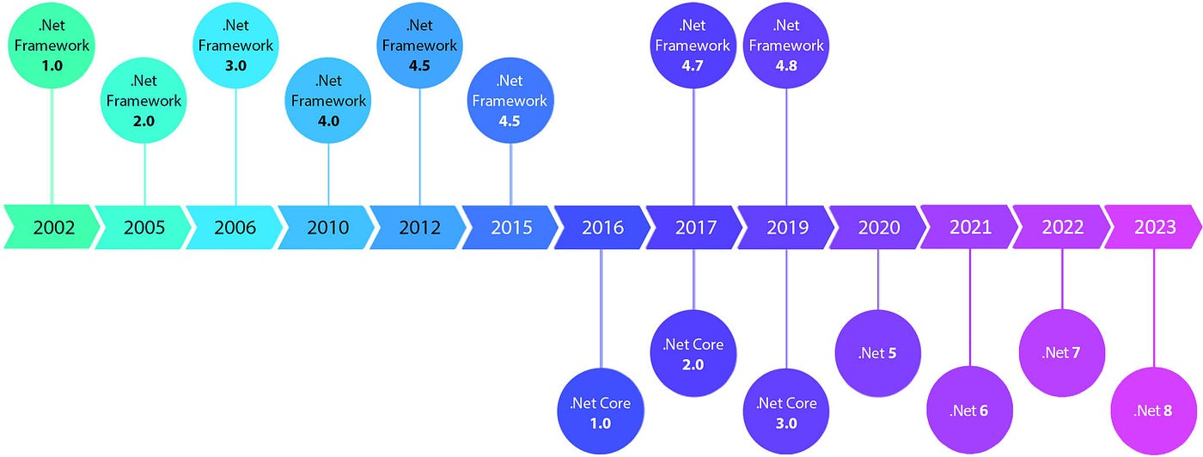
An Overview of the History of .NET Frameworks
Both .NET Framework and .NET Core were supported simultaneously as 2 distinct frameworks – until they were unified into a single SDK as of .NET 5.0

Slide 4
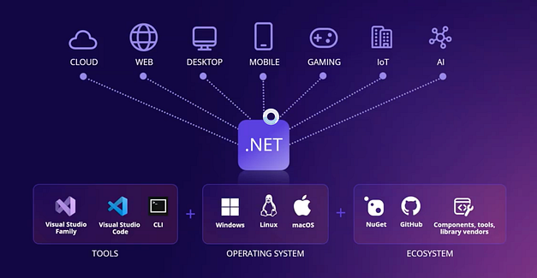
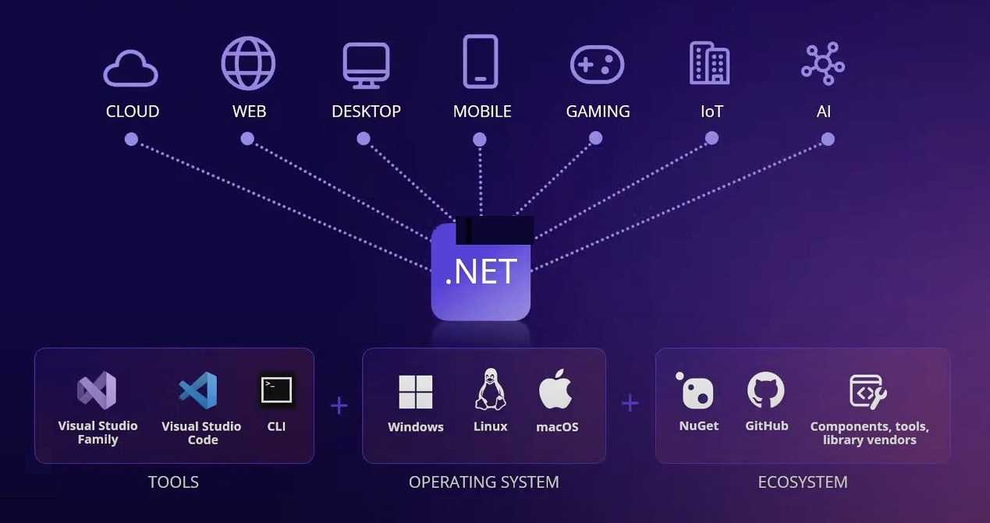
MODERN .NET SUPPORTS MANY OUTCOMES

Slide 5




INTRODUCTION TO ASP.NET
ASP.Net provides a complete, flexible framework for creating web applications in a variety of different patterns, including utilizing MVC Architecture
The ASP.Net MVC framework is:
  Lightweight
  Flexible
  Highly Testable
  Integrates with many existing ASP.Net features
  Provides robust (& unique) functionality
Modern ASP.NET Projects can leverage many of the newest frameworks and services for faster development

Slide 6
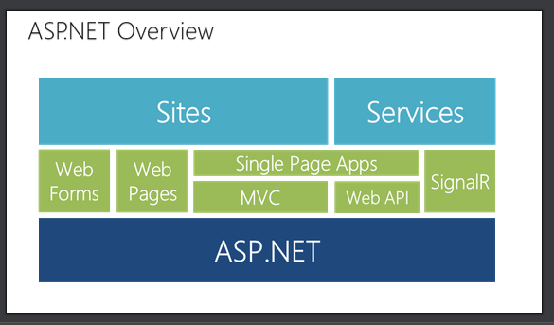
ASP.NET – Project Types

Slide 7
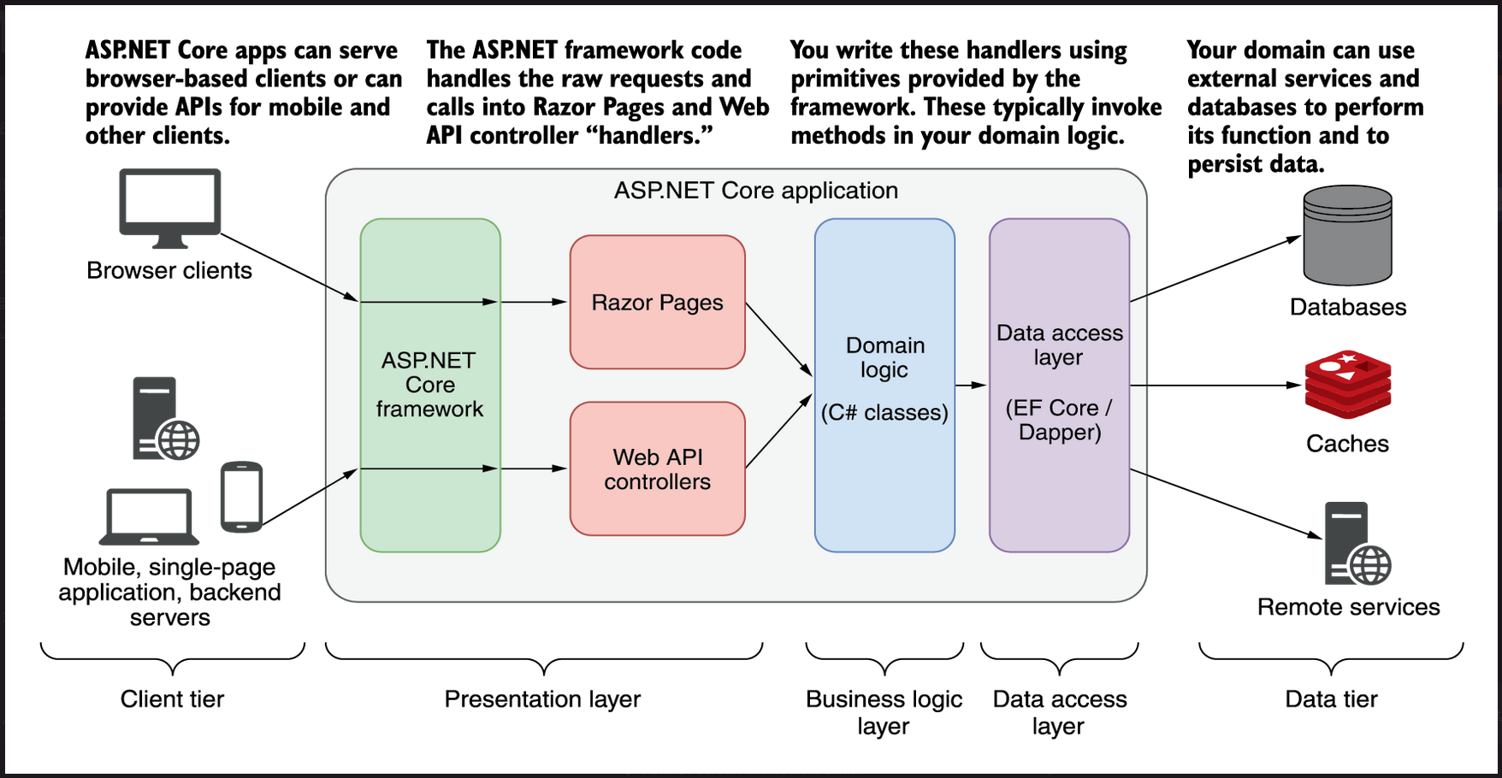

Slide 8
REVIEW: The MVC Design Pattern
MVC is a design pattern that stands for Model-View-Controller.
What it strives to do is separate the concerns of an application’s presentation layer by assigning specific roles to the three different components.
The MVC Design Pattern has been used for many years – and it did NOT originate with Microsoft
REFERENCE: https://medium.freecodecamp.org/simplified-explanation-to-mvc-5d307796df30

Slide 9
Advantages of MVC Web Apps
Easier management of complexity by dividing an application into the model, the view and the controller
The MVC framework is ideal for developers who want full control over the behaviour of the application
It uses a front controller pattern that processes web application requests through a single controller. This enables you to design an application that supports a rich & dynamic routing infrastructure
It provides better support for TDD (Test-Driven Development)
It works well for web applications that are supported by large teams of developers and for web designers who need a high degree of control over the application behaviour
MVC Web applications often run faster and render better HTML content

Slide 10
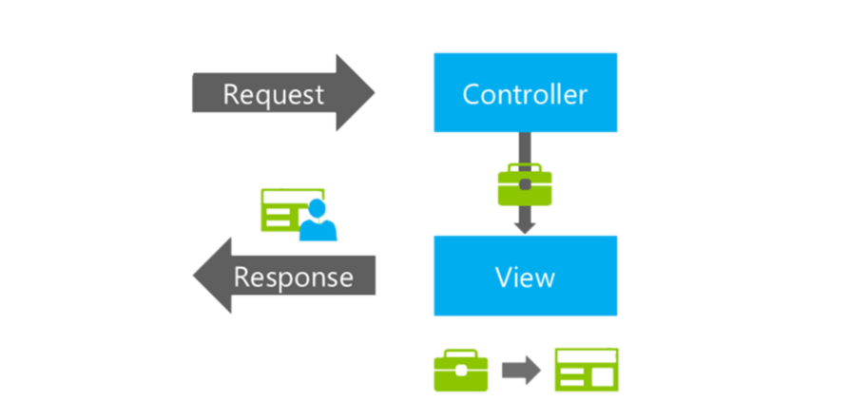

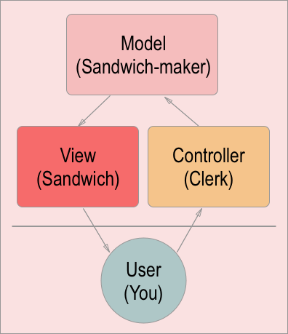
An MVC Architecture In-Action
CLIENT
SERVER

Slide 11
So…What is MVC?
The Model-View-Controller (MVC) architectural pattern separates an application into 3 main components:
  The Model
    Models are classes that represent the data of the application and use validation logic to enforce business rules for that data
    Model objects are the parts of the application that implement the logic for the application’s data domain. Often model objects retrieve and store model state in a database.
  The View
    Views are the components that display the application’s user interface. Typically this UI is created from the model data. An example would be an edit view of a products table that displays text boxes, drop-down lists, and check boxes based on the current state of a product object.
    Views are template files that your application uses to dynamically generate HTML responses

Slide 12
So…What is MVC – PART 2
  The Controller
    Controllers are classes that handle incoming requests to the application, retrieve model data, and then specify view templates that return responses to the client.
    Controllers …. control things in MVC. They are the components that handle user interaction, work with the model, and ultimately select a view to render that displays the UI.
    In an MVC application the view only displays information, the controller handles and responds to user input and interaction. For example, the controller handles query string values and passes these values to the model, which in turn might use these values to query the database.

Slide 13
Working with the MVC Design Pattern
The MVC pattern helps you create applications that separate the different aspects of the application (input logic, business logic, and UI logic), while providing a loose coupling between these elements.
The pattern specifies where each kind of logic should be located in the application.
  The UI logic belongs in the view.
  Input logic belongs in the controller.
  Business logic belongs in the model.
This separation helps you manage complexity when you build an application, because it enables you to focus on one aspect of the implementation at a time (ex: you can focus on the view without depending on the business logic)
The loose coupling between the 3 main components also promotes parallel development.
  For example: one developer can work on the view, another can work on the controller logic, and a third can focus on the business logic in the model.

Slide 14
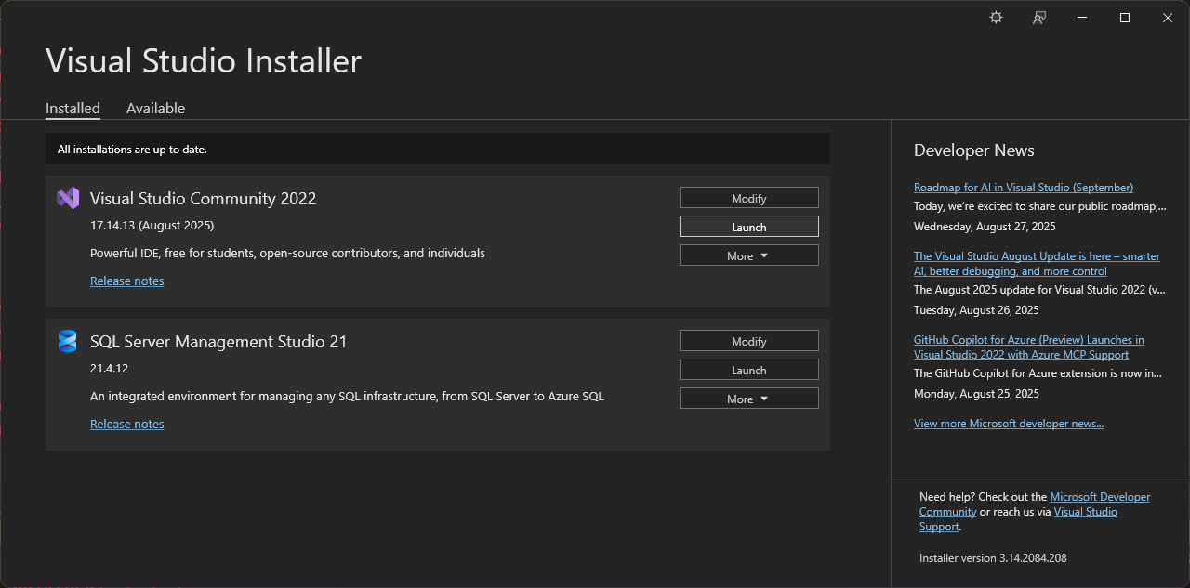
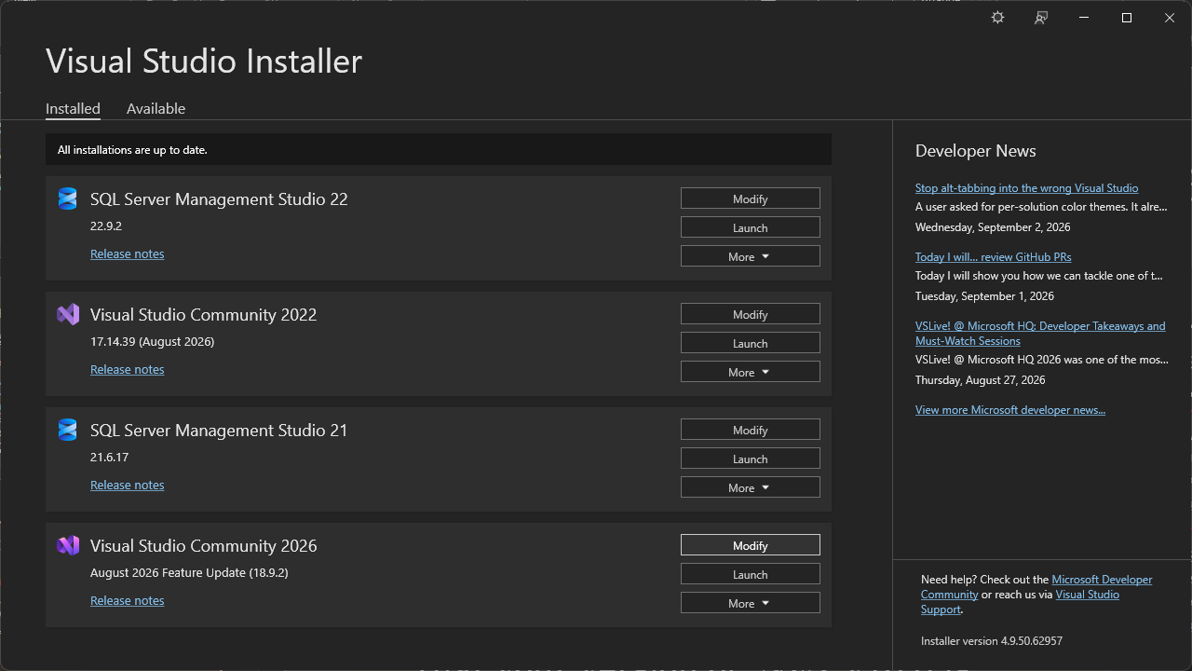
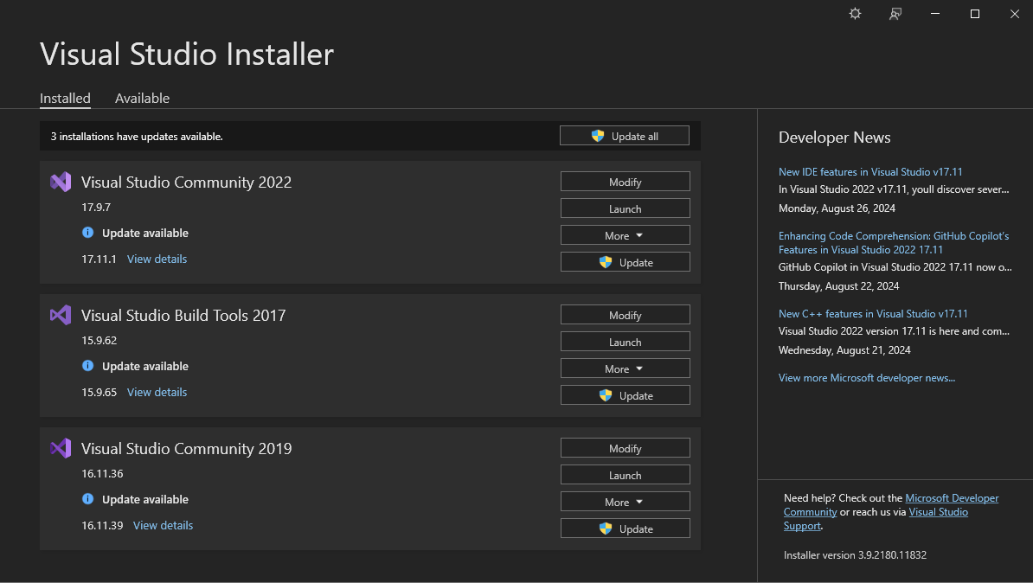
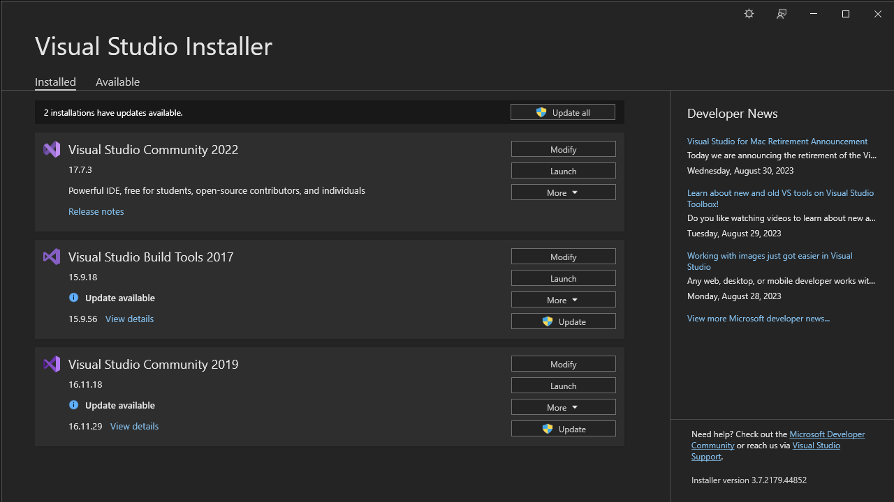
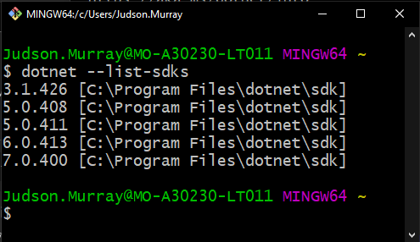
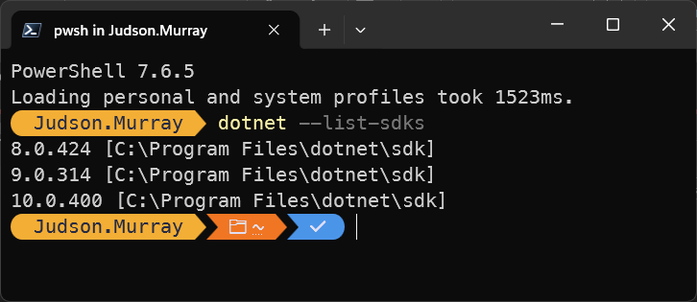
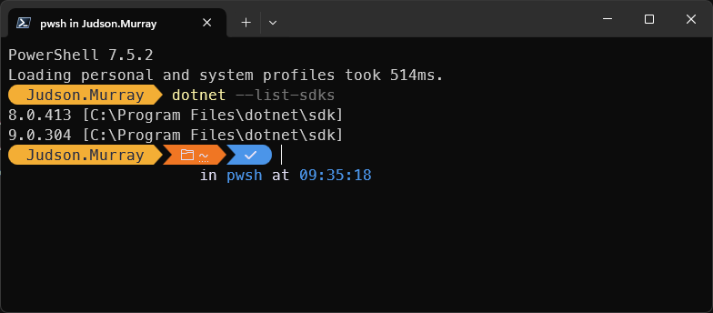
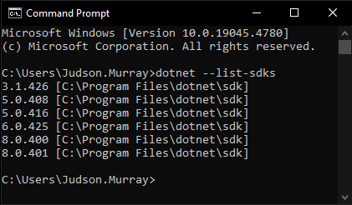
Preparing for Development in ASP.NET Core
Launch the Visual Studio Installer
Ensure that you have Visual Studio 2026 installed
  This must be updated to v18.19.2 (or greater)
  Once Visual Studio is updated, ensure that your version of .NET v10.0 is v10.0.400 or greater
Note: Versions of SDKs and IDEs are inter-dependent. Do not try installing older versions of IDEs with newer versions of SDKs (as they will not work correctly)

Slide 15
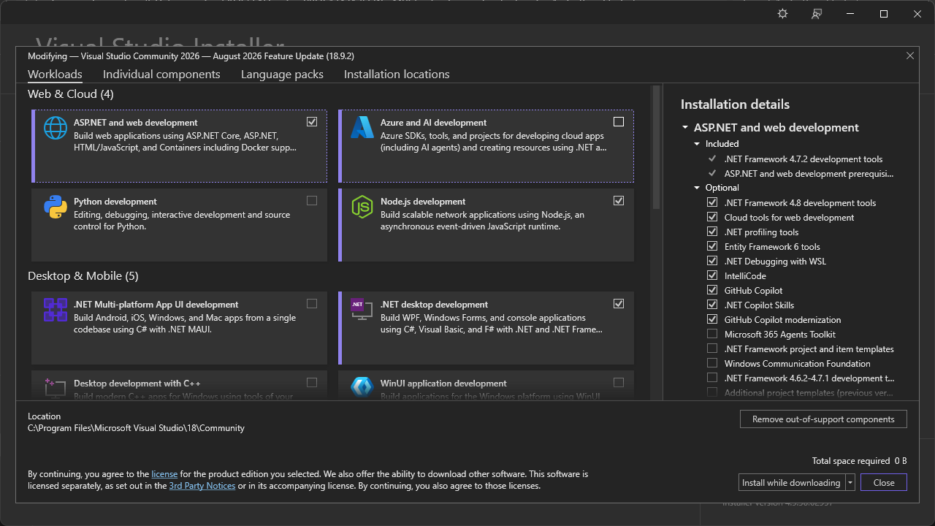
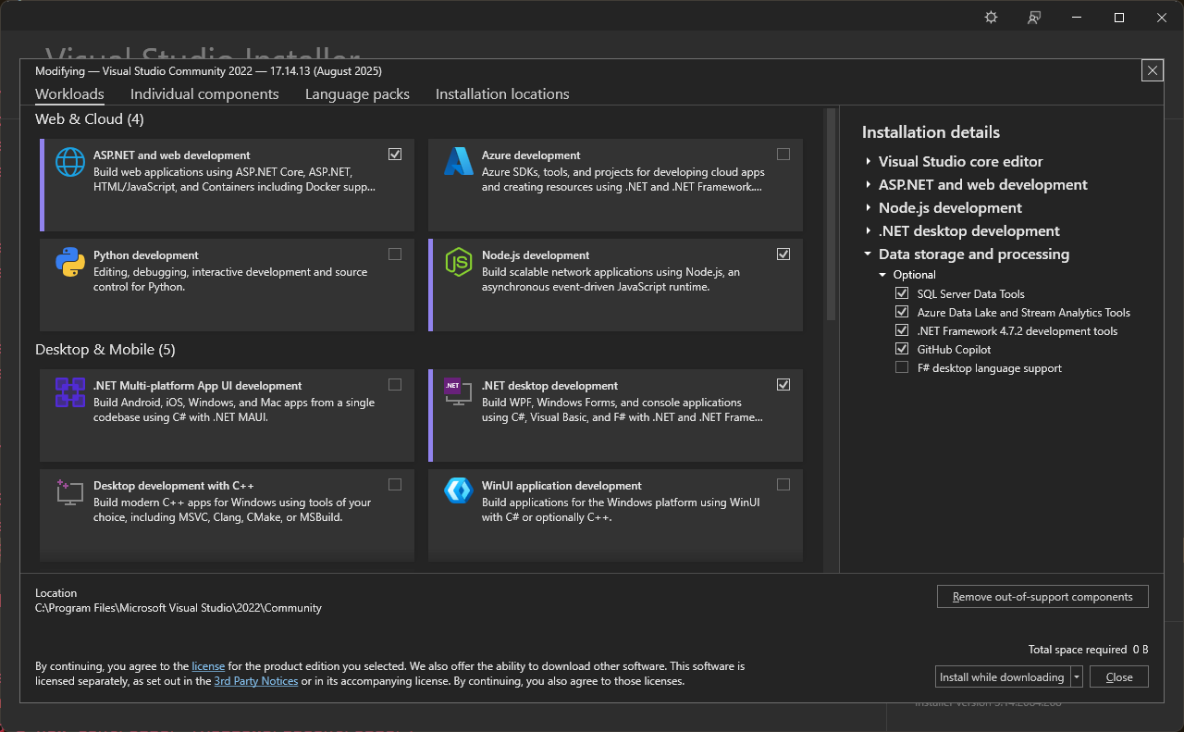
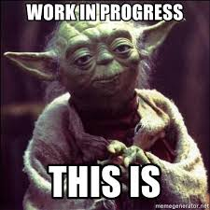
VISUAL STUDIO – WORKLOADS
(& AVAILABLE PROJECTS)
NOTE: If you do not see ASP.NET Core projects within the available list of choices when creating a new Project, ensure that you have the ASP.NET and web development workload selected/installed within your version of Visual Studio using the Visual Studio Installer

Slide 16
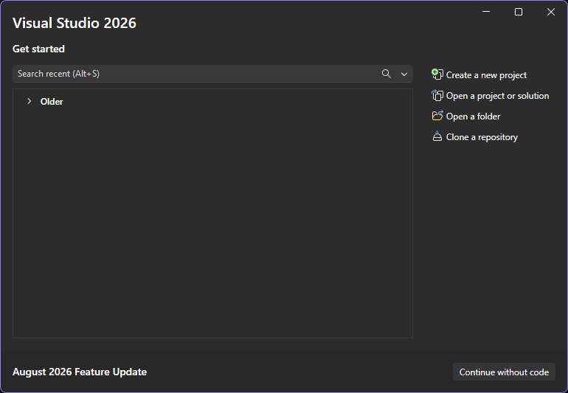
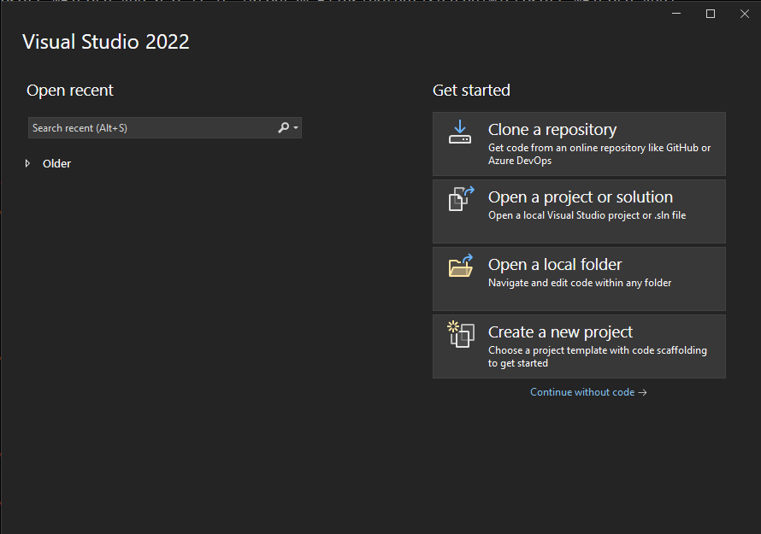
Getting Started
Let’s get our feet wet now and create our First Application in ASP.NET Core

Slide 17
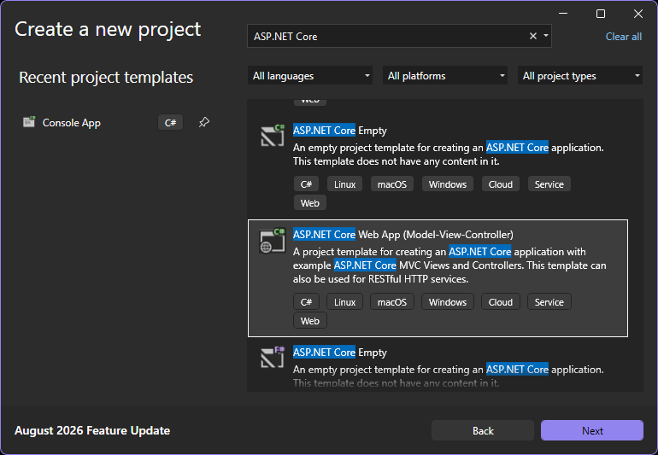
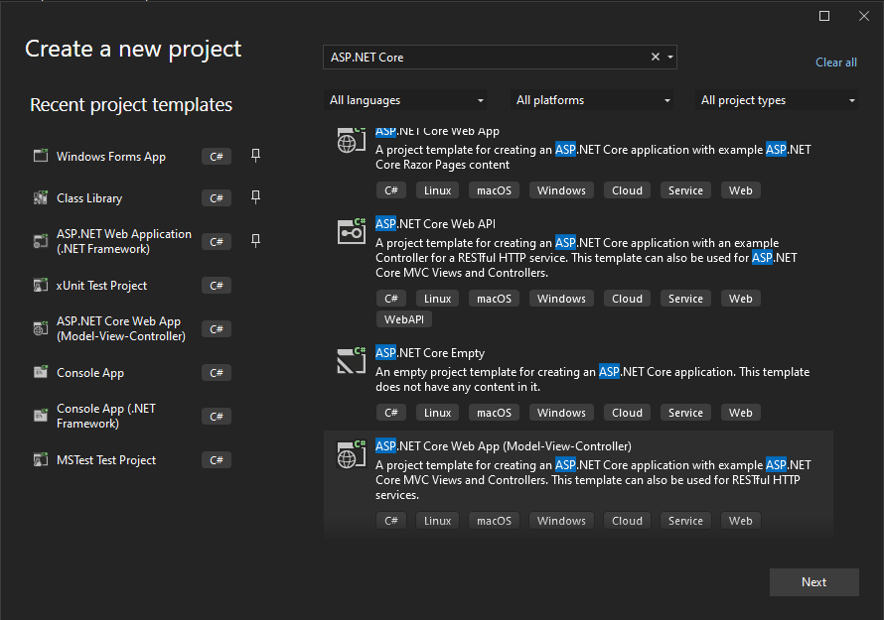
CHOOSE YOUR PROJECT TYPE
1
NOTE: There are many types of ASP.NET Projects (both .NET Framework and .NET Core)
Ensure you pay close attention to the naming. Using the Project Name Filter is very helpful
2

Slide 18
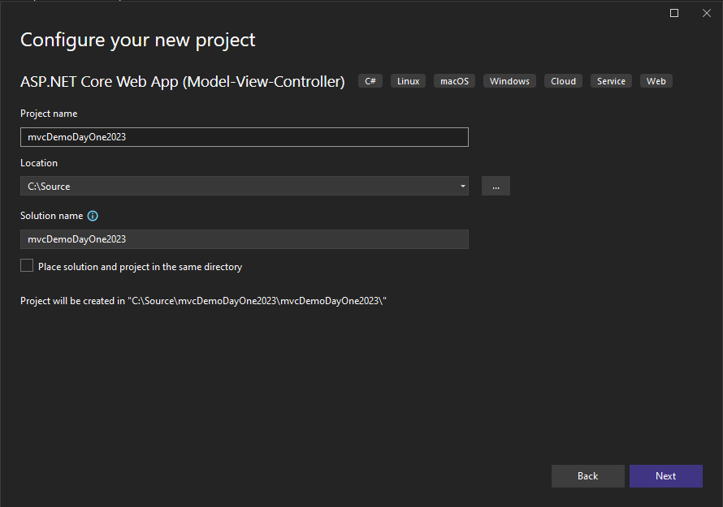
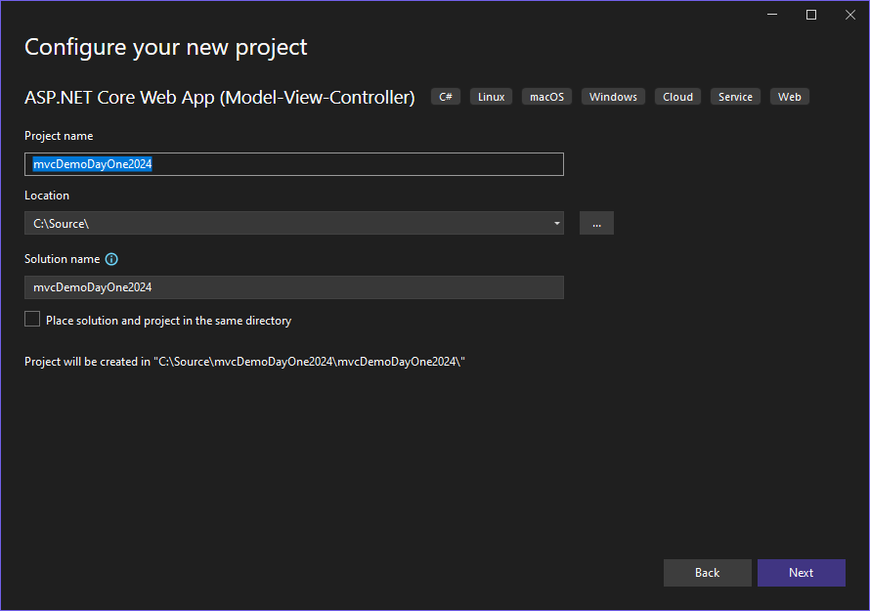
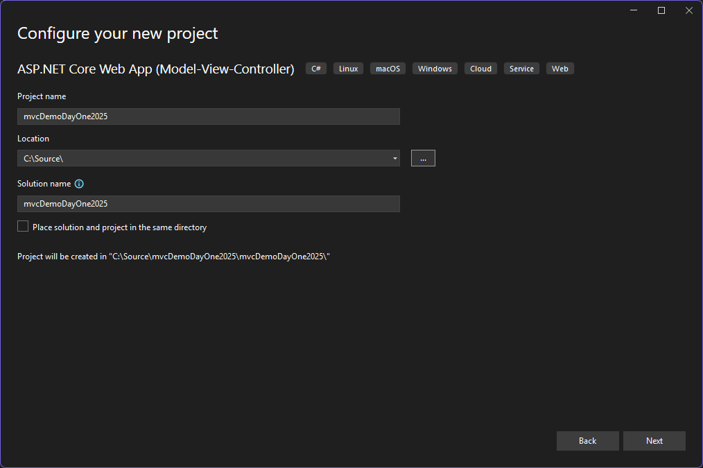
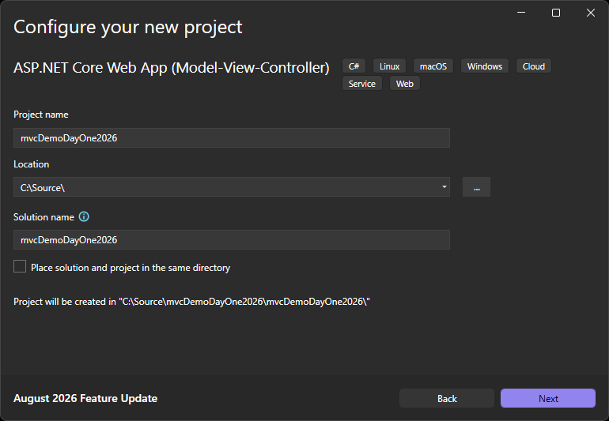
PROJECT CONFIGURATION
1
1:
SELECT THE NAME
FOR YOUR PROJECT
2:
CHOOSE THE PATH FOR
YOUR PROJECT (KEEP THIS
AS SHORT AS POSSIBLE)
2

Slide 19
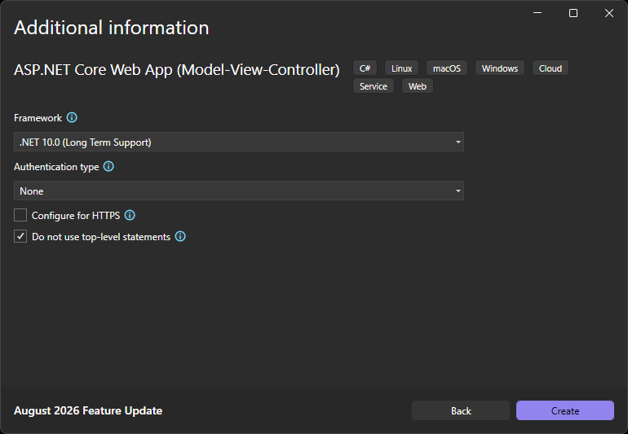
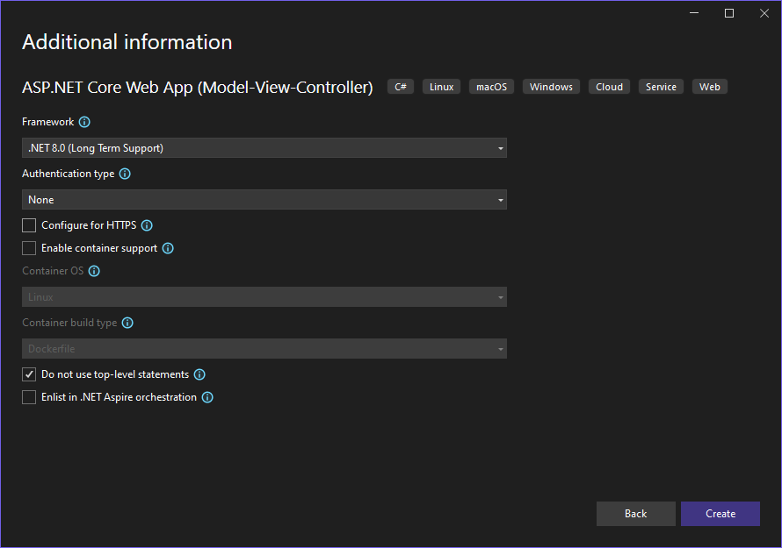
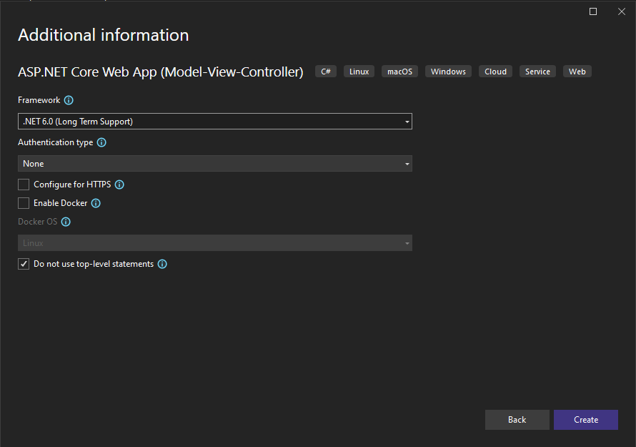
ADDITIONAL PROJECT INFORMATION
1
2
Ensure to select/deselect each of the following features for this demo before finishing the Project Wizard
3
4
5

Slide 20
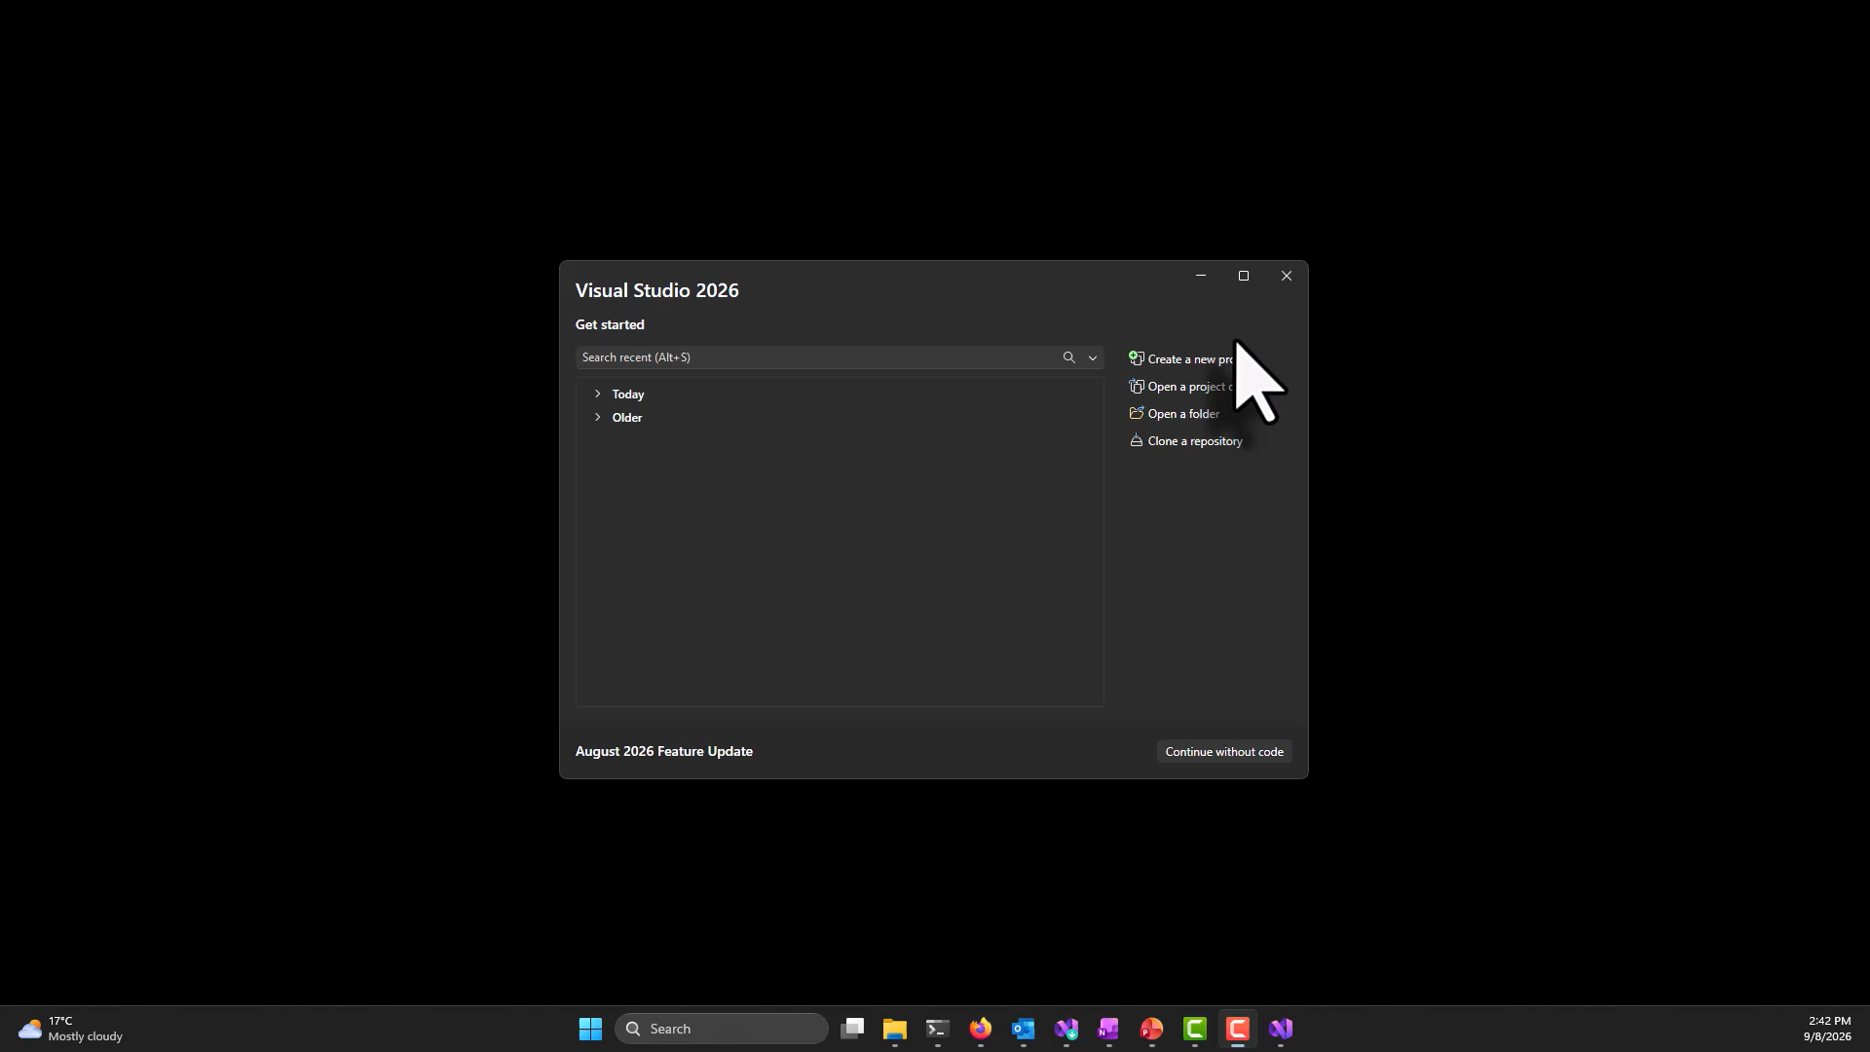
(CREATION WALKTHRU VIDEO)

Slide 21
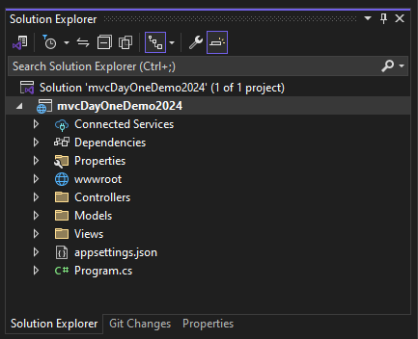
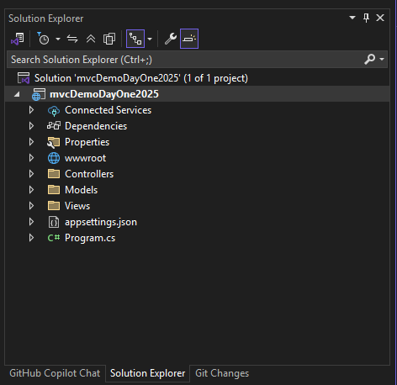
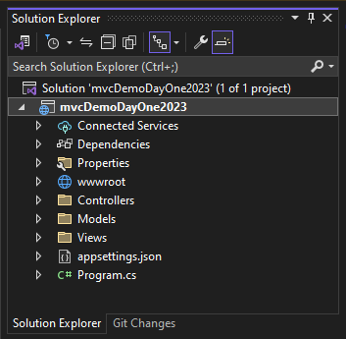
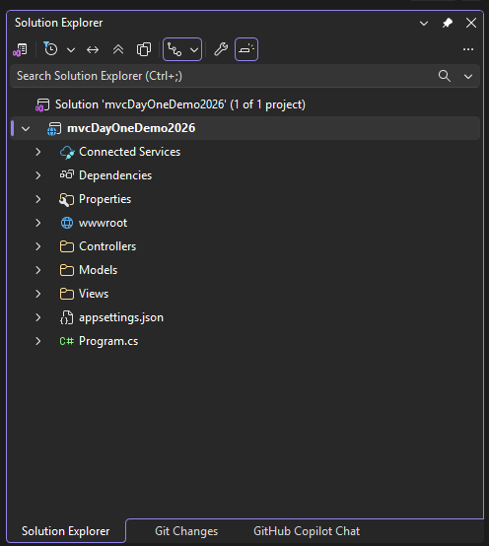
PROJECT STRUCTURE
You will note that we have several areas that are named to match our chosen Design/Implementation pattern of MVC

Slide 22
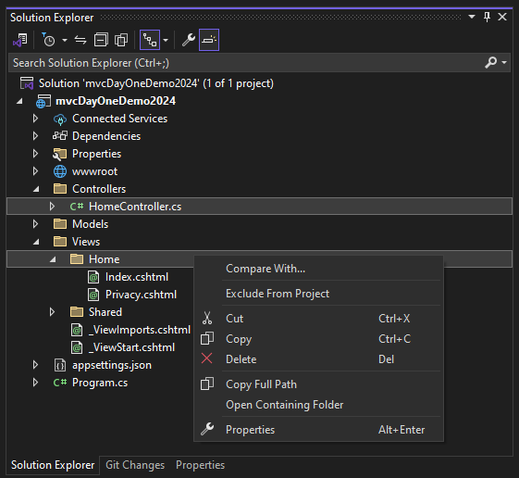
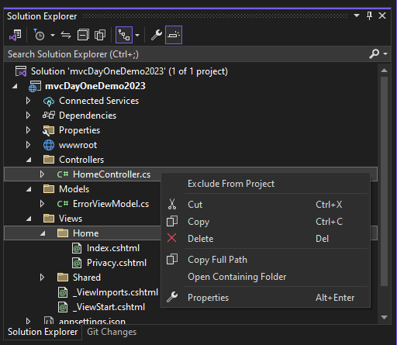
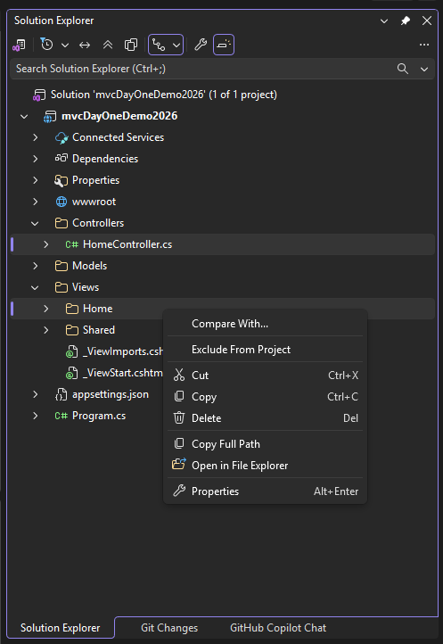

FIRST STEPS – LET’S GO BACK TO BASICS
We are going to remove 2 elements that were Scaffolded (auto-generated) for us before we continue:
The file Controllers/HomeController.cs
The folder Views/Home (and all of its contents)

Slide 23
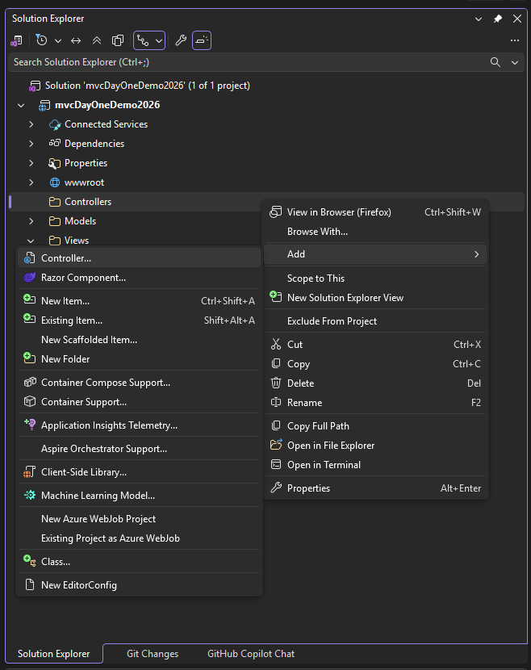
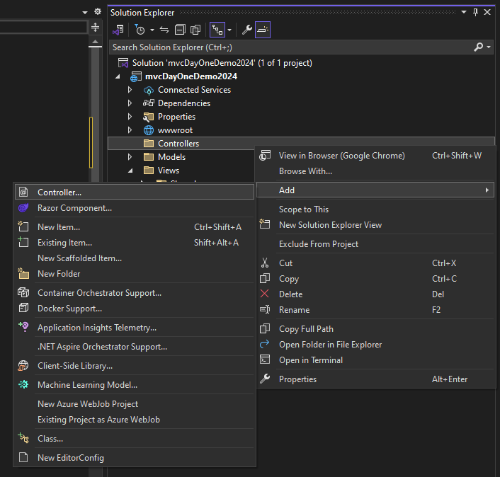
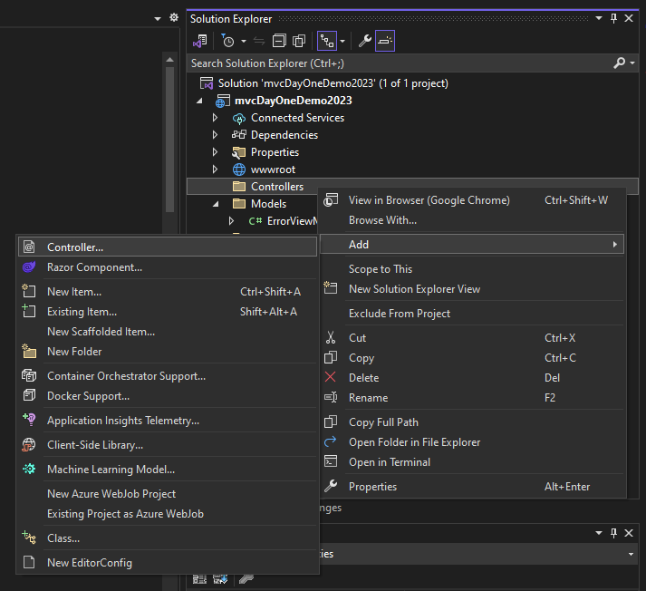
ADDING A NEW CONTROLLER
Right-click on your Controllers folder
ADD ▶ CONTROLLER

Slide 24
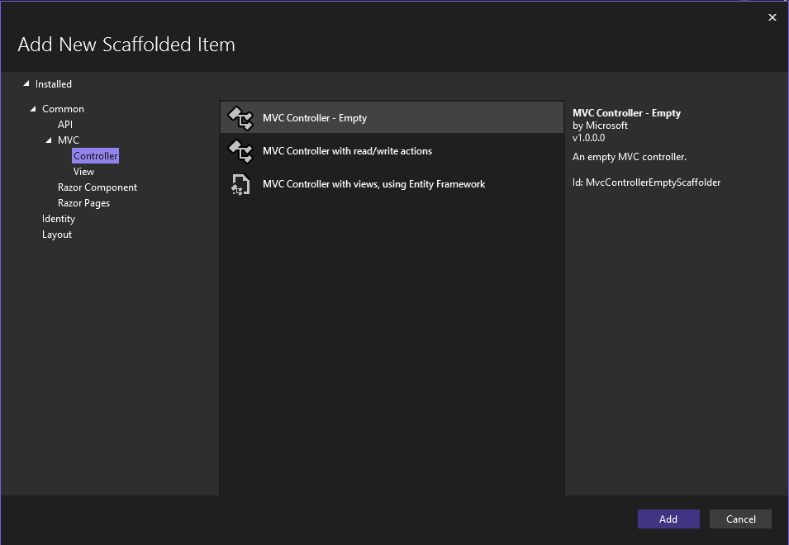
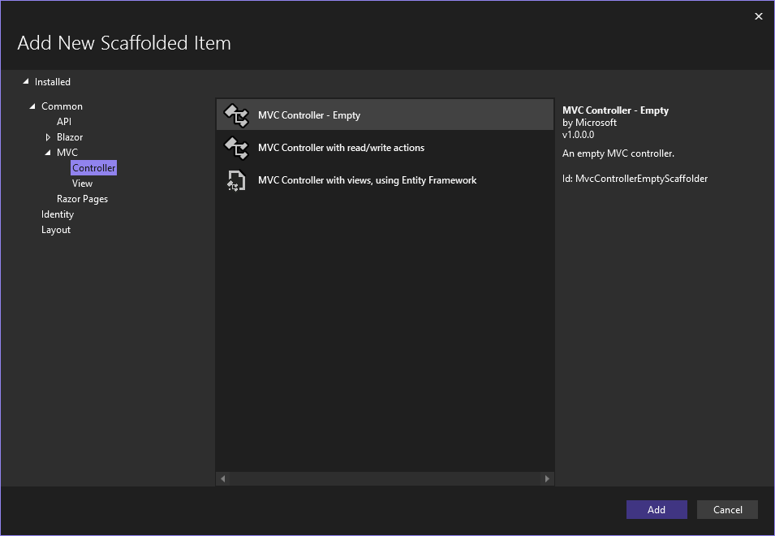
CHOOSE CONTROLLER OPTIONS
Choose an Empty MVC Controller, so we can provide our own content upon creation

Slide 25
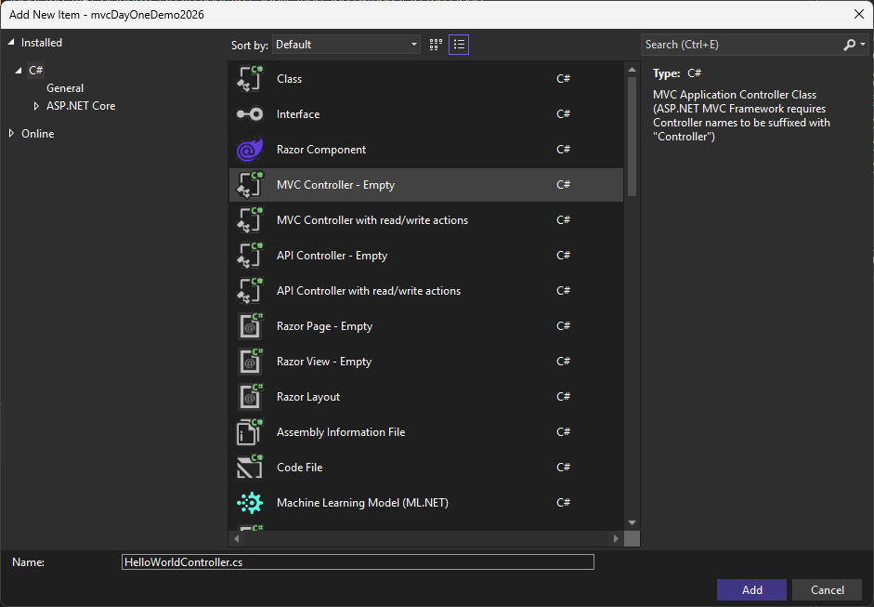
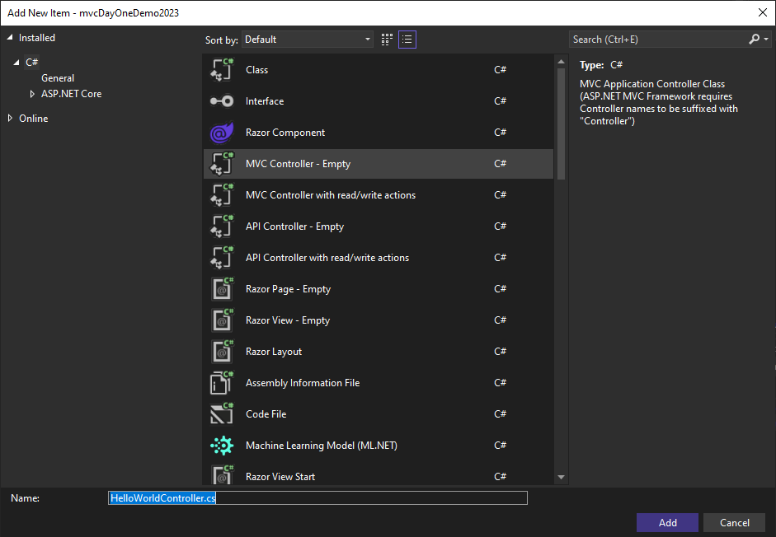
CREATING THE HelloWorldController
Modify the default name of the Controller as required.
All Controllers must end their names with Controller, so do not remove this portion of the name.
Examples:
HelloWorldController
AvatarController
WorldDominationController

Slide 26
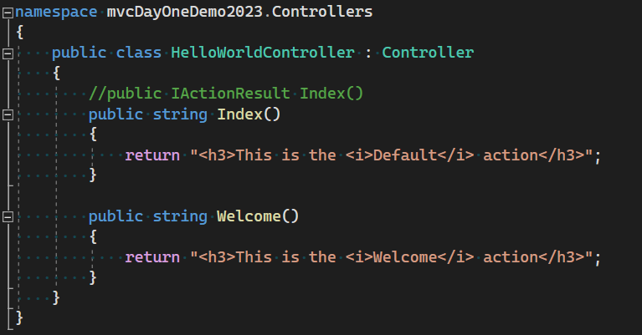
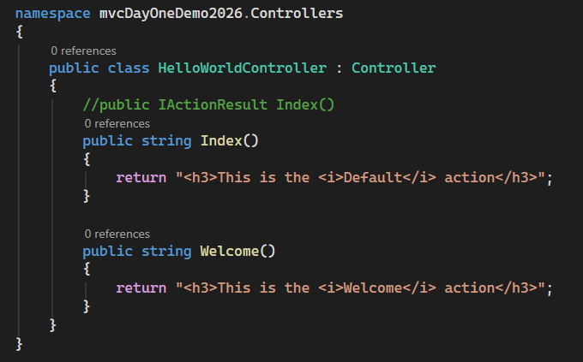
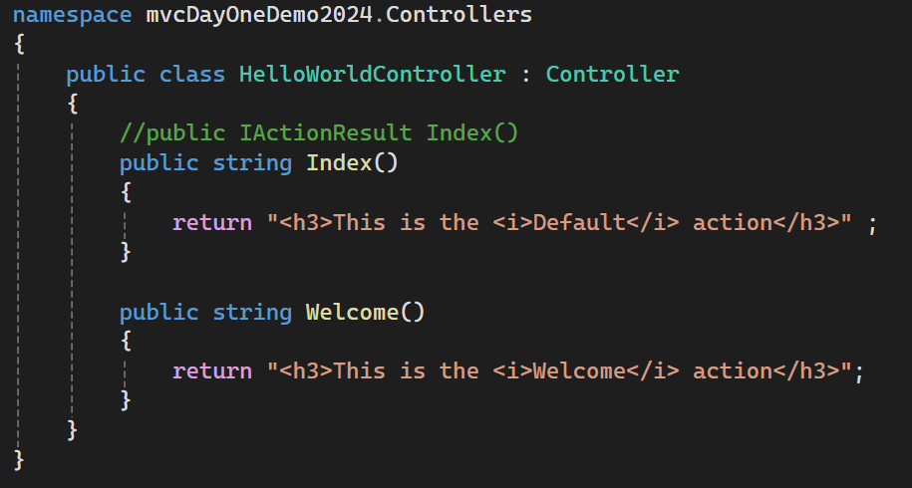

MODIFY DEFAULT IMPLEMENTATION
Implement the methods as shown, with these specific return types.

Slide 27


Running your ASP.NET Project
Launching your ASP.NET website can be as simple as selecting Debug / Run. However, if you select 🔽 you will be prompted with many more options for custom execution, which include:
Web Browser default
Execution Environment
+ more options

Slide 28

Launching our Current Project
HOUSTON, WE HAVE A PROBLEM 🚀
FYI – These Port numbers are randomly generated for each separate project – so ensure to use the correct ones for your current project
http://localhost:5167/HelloWorld
http://localhost:5167/HelloWorld/Welcome

Slide 29
The Result
ASP.Net project that use MVC invoke different controller classes and different actions within them based upon the incoming url
The default mapping logic uses the following format to determine what code to invoke:
/[Controller]/[ActionName]/[Parameters]
  You view/modify the format for routing within Program.cs
The first part of the url determines the controller and the second part determines the action.
  Notice that we only have to browse to /HelloWorld and the Index method was used by default.
  This is because a method named Index is the default method(action) that will be called on a controller if one is not explicitly specified

Slide 30




ASP.NET PROJECT CONFIGURATION
Program.cs is used by an ASP.NET project to choose the separate components and services that the server will utilize. We will be making changes to the default implementation(s) as we make more complex projects.
It also contains configuration information about on the mapping of URLs to Controllers/Actions (and provides defaults)
NOTE: This area will have different initial styling/configuration depending on the options you choose when creating your ASP.NET Project
Default Project Routing

Slide 31






Reviewing the Results
Once we navigate to the correct URLs of our Controllers/Actions, we see the results that we crafted – but perhaps not in the expected format.
Web Servers can host and provide many types of content : Images, Video, XML/HTML – as well as straightforward text.
Our results are being interpreted as straightforward text due to returning raw strings. We will have to tweak our Controller action(s) to return content that will identify as X/HTML:

Slide 32

Using Parameters in Controller Actions
Modify the Welcome() method to add parameters to the method signature as well as create dynamic content.
Once complete, run the project and use this URL:
  http://localhost:xxxx/HelloWorld/Welcome?name=Johnny&age=25/

Slide 33
NOTE
In these small examples the controller has been doing the work of the view as well as the controller by returning html directly.
Ordinarily you don’t want controllers returning HTML directly (it becomes too cumbersome to code), so next we will learn how to create a view template file to help us generate an appropriate html response.

Slide 34
Views with Razor
Thru the history of ASP.NET in the .NET Framework, versions of ASP.Net MVC used web forms as the view engine, starting in ASP.Net MVC 3 we were able to use the new Razor view engine.
ASP.NET Core have created a newer implementation of Razor, which leverages the original syntax as well as provides newer syntax to provide even more elegant View implementations. We will be learning aspects of both.
Razor based view templates will have a .cshtml file extension (when using C#) or .vbhtml (when using VB) and provide an elegant way to create HTML output using either C# or VB.
Razor minimizes the number of characters and keystrokes required when writing a view template, and enables a fast and fluid coding workflow

Slide 35




Adding a View Template
Let’s change the Index method of the HelloWorld controller to return a View object:
  Public IActionResult Index()
  {
  return View();
  }
This code uses a view to generate an HTML response to the browser.
We will need to now add the required view: in the code window right click the Index method and click ‘Add View’
Leave the defaults as shown in the dialog box shown on the right and click ‘Add’
In solution explorer, you will see a HelloWorld views folder and the Index.cshtml view has been created
(right click)

Slide 36




Launch the Web Server – and invoke HelloWorld Index Action
Looking good – but where did these elements come from?

Slide 37

Reviewing the Project Layout
Some of the content of our displayed page was from our View Template – but most of it was not.
Common implementation that should be reused across the entire site is provided by a Project Layout
(Views ▶ Shared ▶ Layout.cshtml)

Slide 38
What are Layouts?
To better understand the relation between Views ➡ Layouts, go back and review the implementation for the HelloWorldController Index view.
What do you notice? Isn’t there some html missing?
What we see in the browser window when we run our application is like a jelly donut...
  The view is the filling inside the donut and the layout is like the donut that wraps the filling
  The html we thought was missing from the view is actually contained in the layout.
Layout templates allow you to specify the HTML container layout of your site in one place and then apply it across multiple pages in your site.

Slide 39



How Layouts interact with a chosen View
Upon closer inspection, you will see where the Layout injects the Razor HTML within the Layout
Content where @RenderBody() is invoked.
The Layout file that is provided is an excellent example – but remember that this is simply a provided
Example. Customization is both possible (and commonly required) as we develop our Website content.

Slide 40
Introduction to Routing
MVC applications also use the ASP.Net routing system
It manages how a URL Request is mapped to specific Controllers & Actions
When Visual Studio creates an MVC project, it adds some default routes to get us started
/Home/Index/optional id
The ASP.Net MVC convention is that if we have a controller called HomeController, it will be the starting point for the application
The default routes provided will follow this convention
The existing routing configuration can be seen by reviewed within Program.cs

Slide 41
“Mission Control – We’ve got a solution”
Our Webserver was returning Error 404 when we ran it because the application was looking for a HomeController…and we didn’t have one
If we gave it the name of a valid controller afterwards, it was ok with that
If you want to have a view that loads by default (similar to a default / index page)… Either:
  Ensure you have a HomeController with a valid Index action – and when a user arrives to the main url of your site, that is what will load
  Modify the default routing to point to an existing Controller / Action combination

Slide 42
Add the HomeController
Right Click Controllers
  Choose Add Controller
  Select MVC Controller - Empty
  Choose the name HomeController (remember to leave the word Controller within the name.. just change the front part of the name)
  (HINT) This is the default name for a new Controller, so you shouldn’t need to modify anything 😀
Right click the Index Action in the controller and choose Add View
  Choose a Razor View (not the Empty option)
  Leave the defaults to create the index view

Slide 43
Passing data from the Controller to a View
Controller classes are invoked in response to an incoming URL request. A controller class is where you write the code that handles the incoming parameters, perhaps does some processing, and ultimately decides what type of response to send back to the browser.
  View templates can then be used from a controller to generate and format an HTML response to the browser.
Controllers are also responsible for providing whatever data or objects are required in order for a view template to render a response to the browser.
  A view template should never perform true business logic or interact with a database directly.
  Instead, it should work only with the data that's provided to it by the controller.
  Maintaining this "separation of concerns" helps keep your code clean and more maintainable.

Slide 44

It’s all in the ViewBag…?
As you saw a short time ago:
  Rather than have the controller render its response as a string, we changed our controller to use a view template instead.
  The view template then generated a dynamic response, and you can pass appropriate bits of data from the controller to the view in order to generate the response.
    You can do this by having the controller put the dynamic data you want to pass to the view template in a ViewBag object that the view template can then access.

Slide 45

ViewBag Implementation example (Controller)
public IActionResult Welcome(string name, int age=0)
{
ViewBag.Message = "Hello " + name;
ViewBag.Age = age;
return View();
}

Slide 46

ViewBag Implementation example (View)
<div id="content">
<h3>@ViewBag.Message </h3>
<p>So I hear that you are @ViewBag.Age years old? Cool!</p>
</div>

Slide 47

ActionLink Code Example

